Slide 1

Lending Patterns
EDA case study to recognize patterns of loan defaulters
By: Snehal Jadhav and Shrey Jain

Slide 2
Context
There is consumer finance company which specializes in lending various types of loans to urban customers.
We are provided with historical data set of loan applicants and whether they ‘defaulted’ or not.

Slide 3
Goal of analysis
The goal is to recognize patterns that suggest whether a person is likely to default or not.
This information can be used to take actions such as denying the loan, reducing the loan amount, or offering loans to risky applicants at a higher interest rate.

Slide 4
Tech stack used
Python 3.9
Jupyter notebook
Libraries:
Pandas
Numpy
Seaborn
Matplotlib

Slide 5
Data description
Historical data consists of:
111 columns
39717 rows
Data type of column values:
float64
int64
object
Dataset contains both numerical and categorical variable

Slide 6
Data exploration and cleaning
Columns with NaN values
Columns with only single value
Metadata and description columns
54 columns with all null values, which we have removed
These columns were having no impact on analysis
Total 9 columns with only having single value
These aare also dropped because of no significant value for analysis
Columns denoting ID, addresses, title, URL, detail description
Total of 8 columns found
These columns were also dropped as this data is not required for the analysis goal of finding patterns on defaulters

Slide 7
Data exploration and cleaning
Post lending columns
Missing values
Date columns
Columns which denotes data values which were taken after loan approval
As the analysis is to find pattern to recognize defaulters before loan approval, we can drop these columns as well
Total of 10 such columns were dropped
Column like emp_length is imputed with mode value as missing values were significant low in number
Revol_util column had only 50 rows with null values, as this number is far low compared to 39K rows, it was much optimistic to drop these rows
Created a separate column based on issue_d column which is issue_year, this column have only the year of loan issue

Slide 8

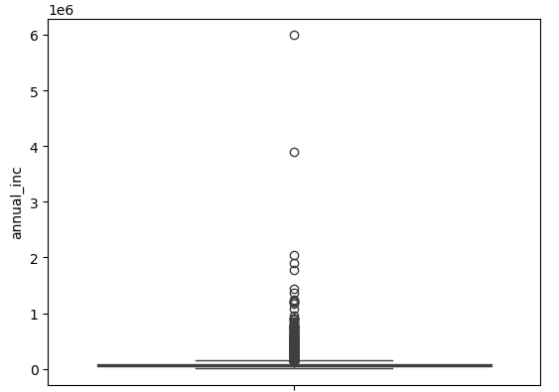
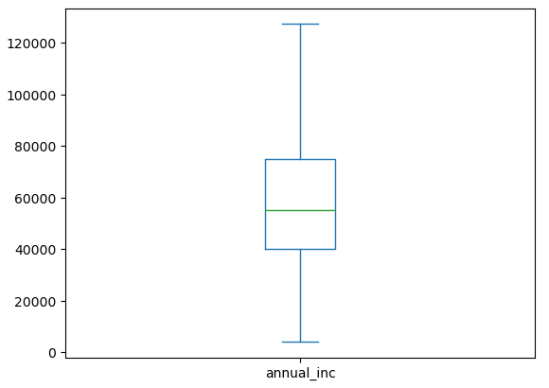
Outlier
Column annual_inc have good number of outliers
This column required outlier treatment
The graph shown here denotes column with outlier an after outlier treatment

Slide 9
Multivariate Analysis
To get correlation among the coumns

Slide 10
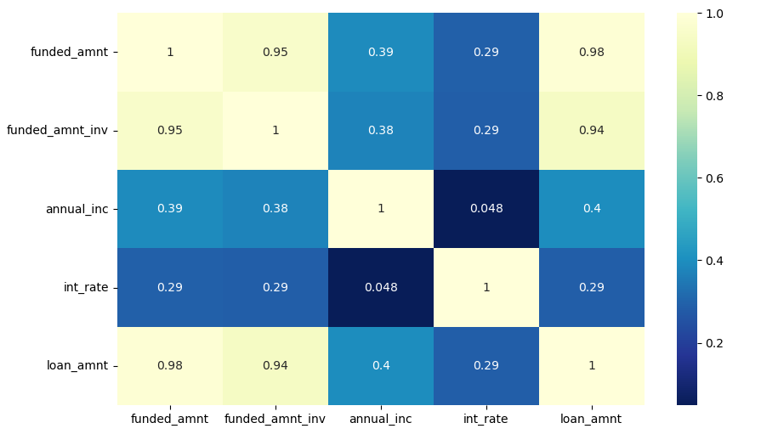
Correlation between numerical columns
fund_amt and fund_amt_inv is almost same as Loan Amount w.r.t Annual Income
We can drop fund_amt and fund_amt_inv

Slide 11
Decision making attributes
Numerical columns
Categorical columns
annual_inc
int_rate
loan_amnt
grade
sub_grade
emp_length
verification_status
home_ownership
purpose
loan_status
term
Target

Slide 12
Univariate Analysis
To check column wise behavior and outlier detection

Slide 13
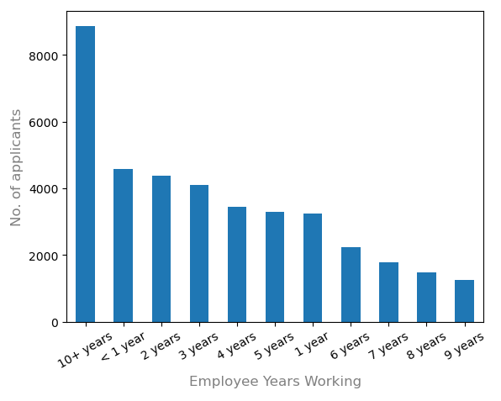
Loan applicants vs Working year
Applicants with >10 years have availed maximum number of loans

Slide 14
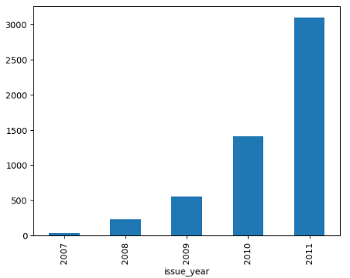
Year wise analysis
Number of defaulters are more in 2011
Possibility some mass event happened like layoffs or recession

Slide 15
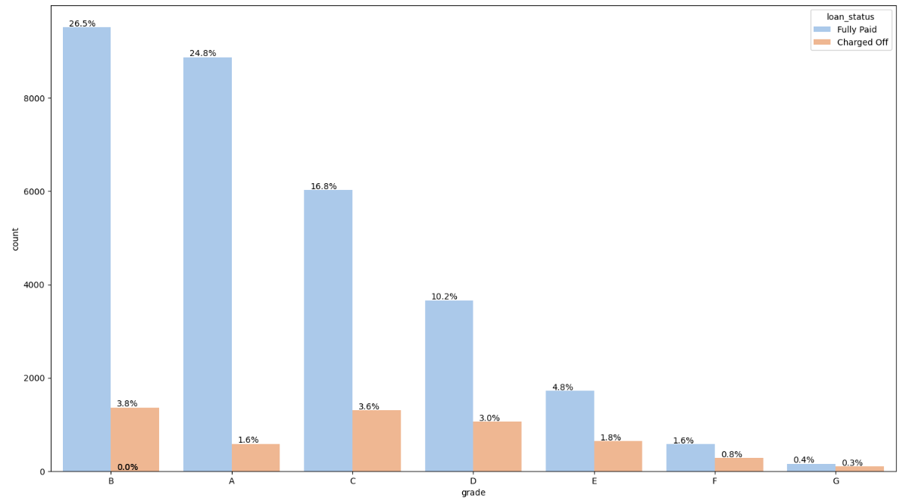
Segmented Analysis: grade
Comparison of number of Fully paid and charged off
The following chart denotes grade wise data
We can see Grade A,B,C,D are having significant large number of non-defaulters than with grades E,F,G

Slide 16
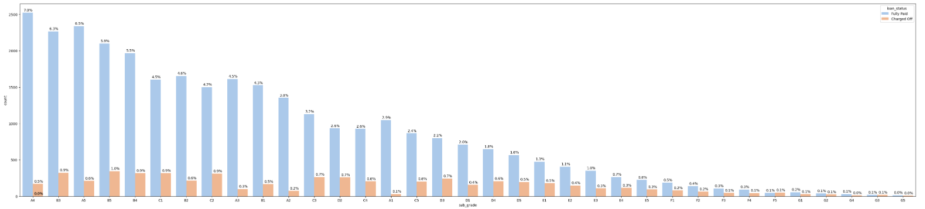
Segmented Analysis: sub_grade
Comparison of number of Fully paid and charged off
The following chart denotes sub_grade wise data

Slide 17
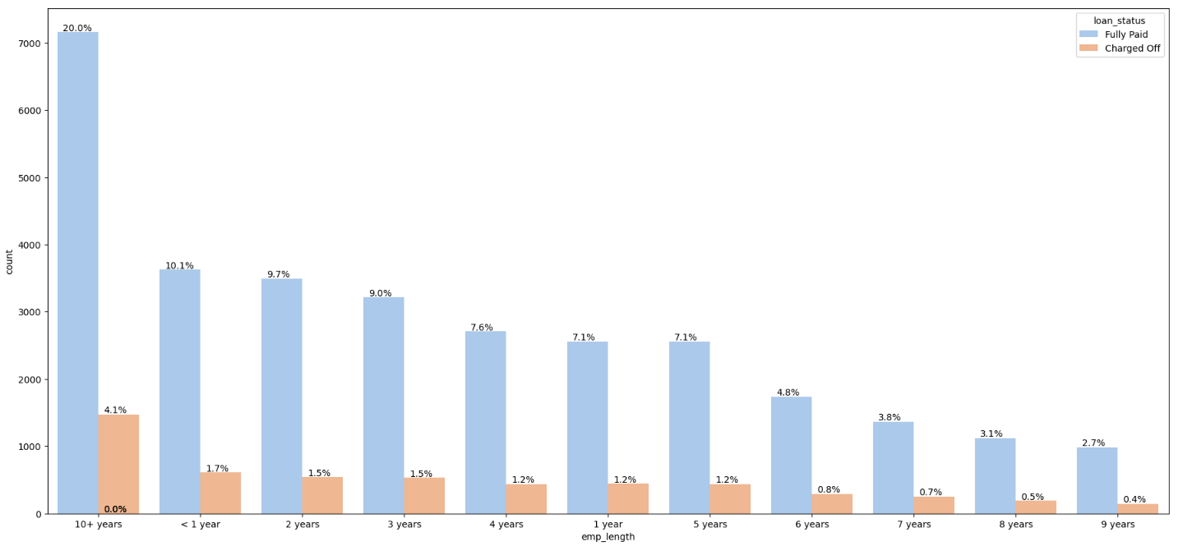
Segmented Analysis: emp_length
Comparison of number of Fully paid and charged off
The following chart denotes emp_length wise data
We can see that employees with >10 years of employment have greater numbe of loans an large number of defaulters as well

Slide 18
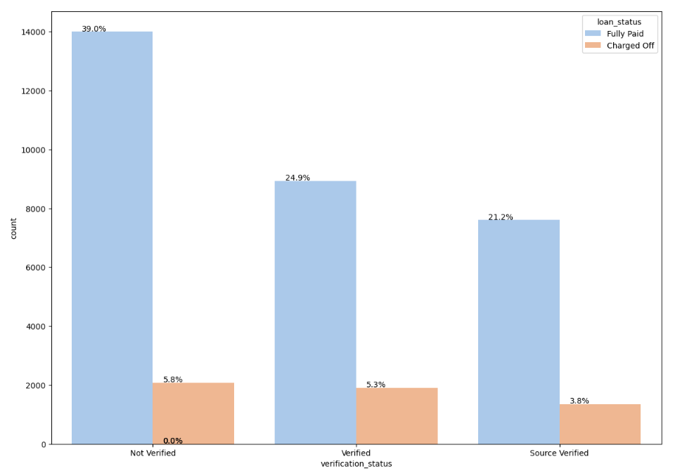
Segmented Analysis: verification_status
Comparison of number of Fully paid and charged off
The following chart denotes verification_status wise data
Observation: verified and source verified have comparative large number of defaulters

Slide 19
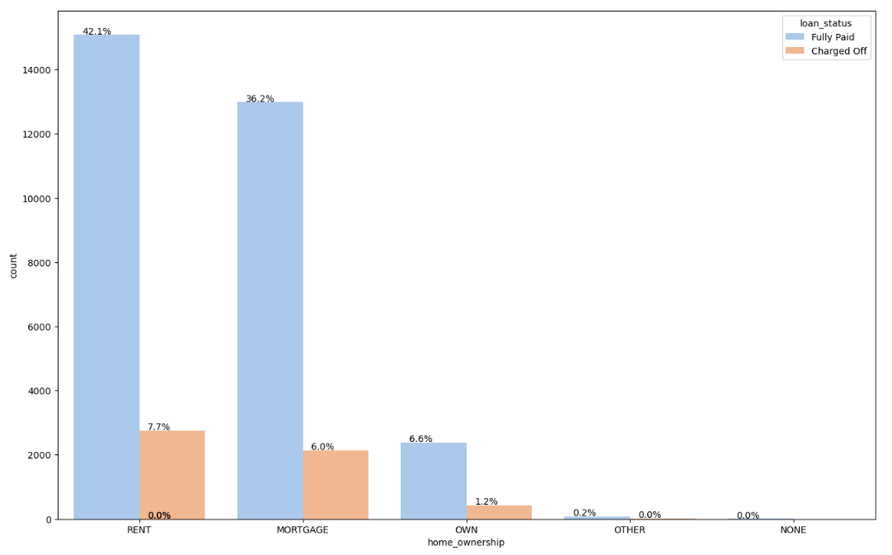
Segmented Analysis: home_ownership
Comparison of number of Fully paid and charged off
The following chart denotes home_ownership wise data
Observation: People with rental or mortgaged home have higher defaulter rate

Slide 20
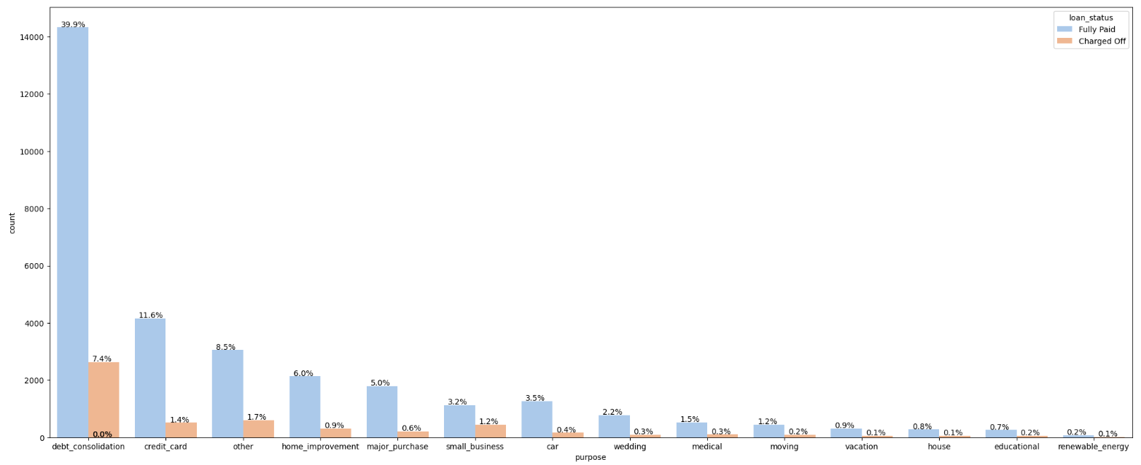
Segmented Analysis: purpose
Comparison of number of Fully paid and charged off
The following chart denotes purpose wise data
Observation: No clear observation by this graph as he values are more.
We may need a probability measure as well on this comparaing defaulters vs non-defaulters

Slide 21
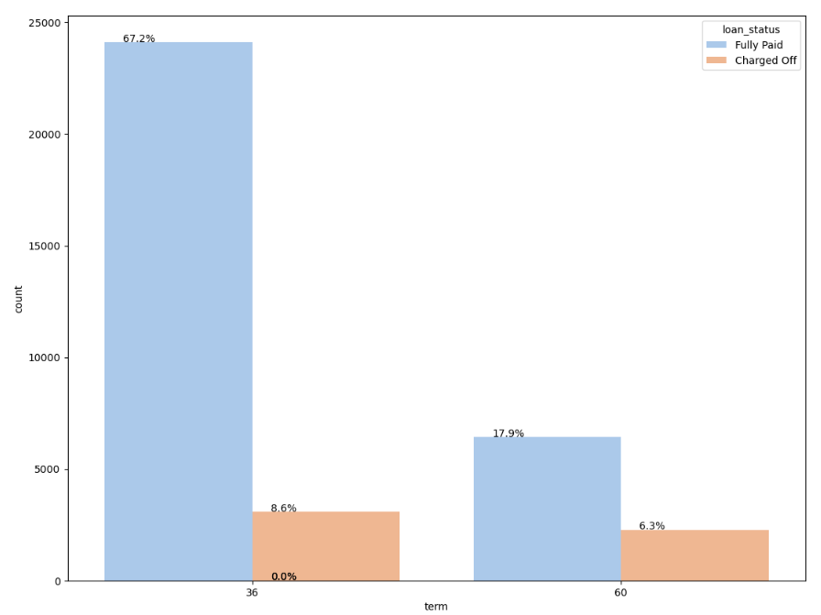
Segmented Analysis: term
Comparison of number of Fully paid and charged off
The following chart denotes term wise data
Observation: Defaulters are more when the loan term is more

Slide 22
Bivariate Analysis
Observing numerical columns and categorical columns

Slide 23
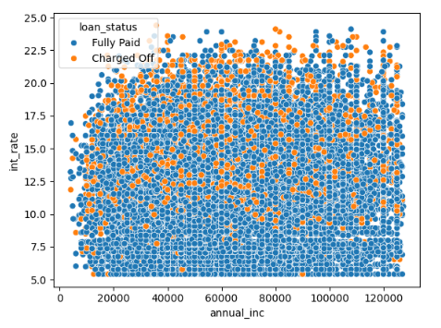
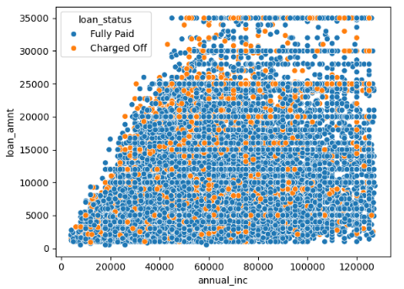
Bivariate analysis of numerical colummns
Did not notice much difference to analyse in terms of Annual Income and Loan amount
As the Interest Rate increases, we set a range of defaulters increasing in the range of 20000 - 60000 annual income bar

Slide 24
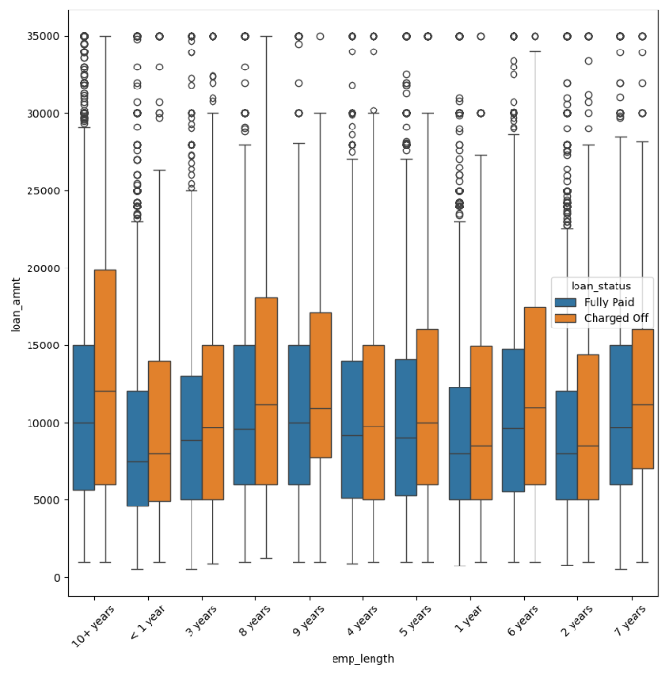
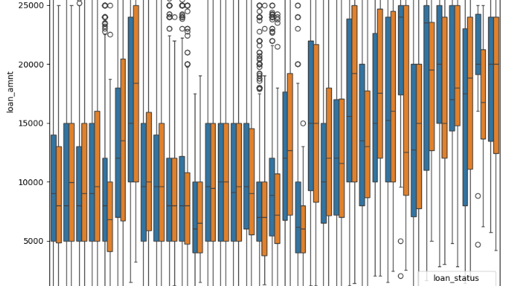
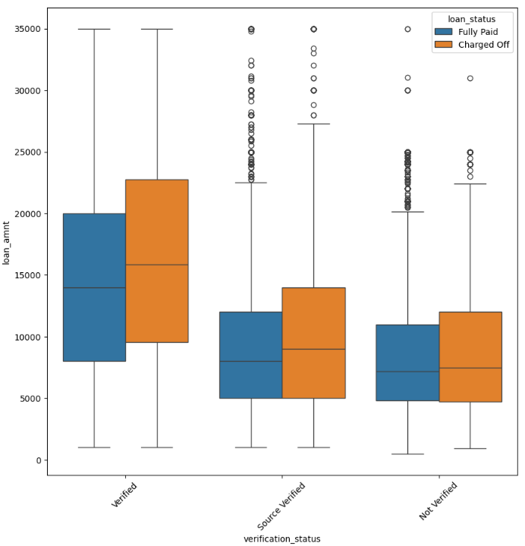
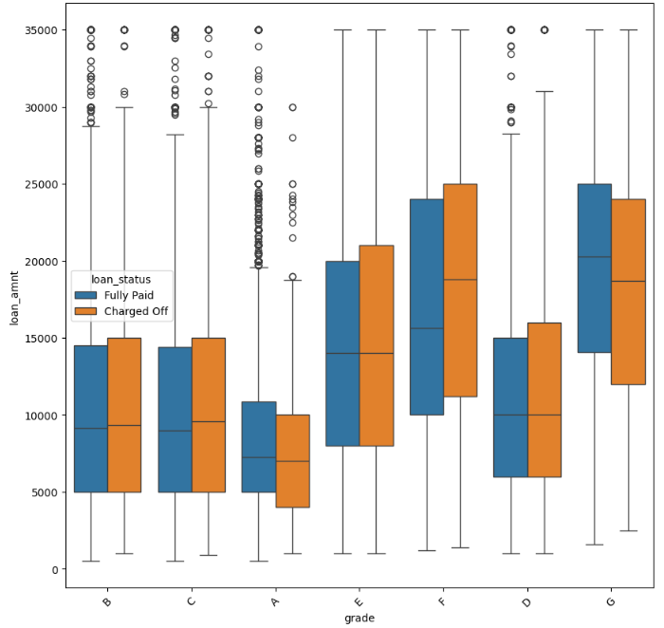
Bivariate analysis of categorical columns
On comparing grade, sub grade, employment length and verification status with loan amount
We found similar analysis like of univariate when comparing these columns with count of defaulters and non-defaulters
This build us a confidence that our analysis is going in right way

Slide 25
Probability of defaulting
Finding which data column have high impact/probability for being a defaulter

Slide 26
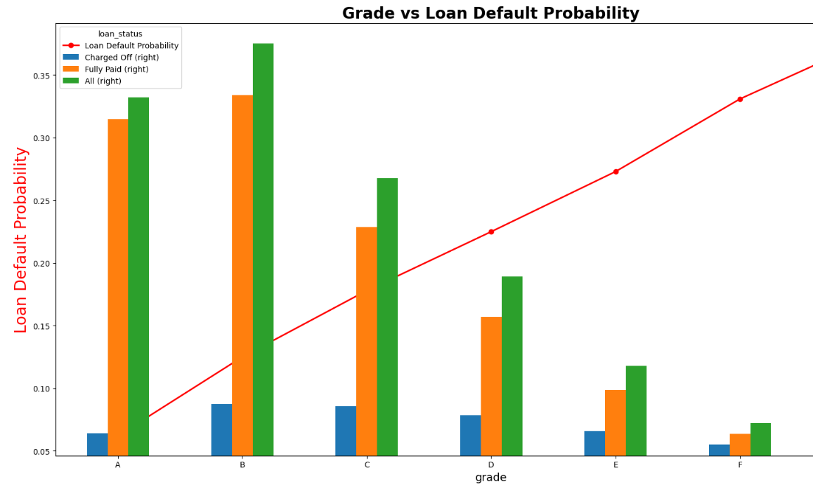
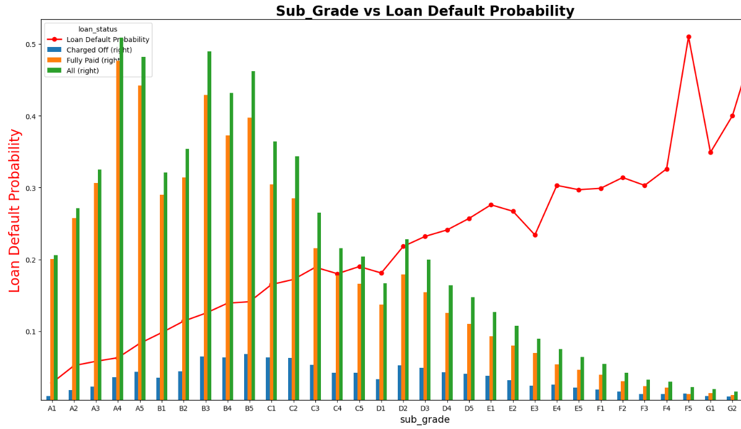
Grade and sub grade
Applicants with grade F and G is having higher probability of being defaulter
Same in sub grades, Fs and Gs are having higher probability of getting defaulted

Slide 27
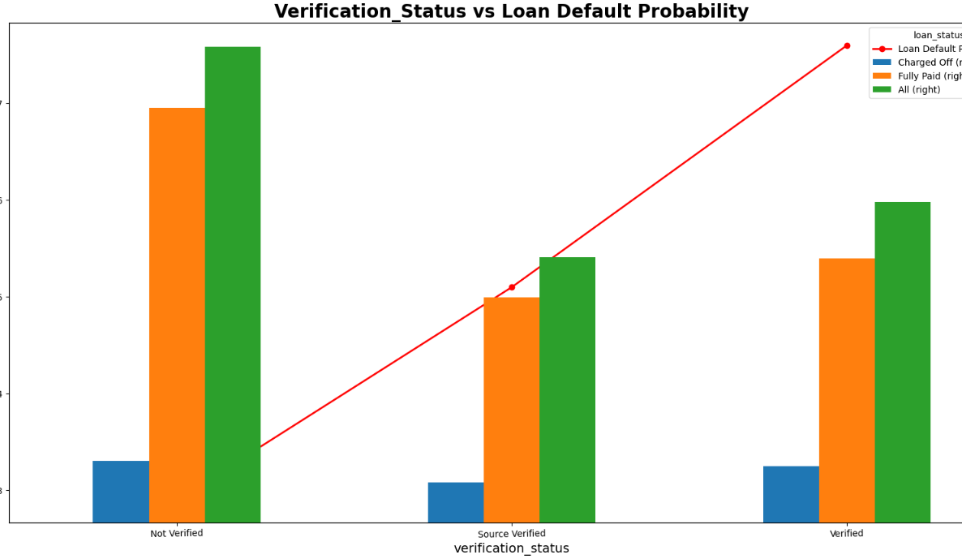
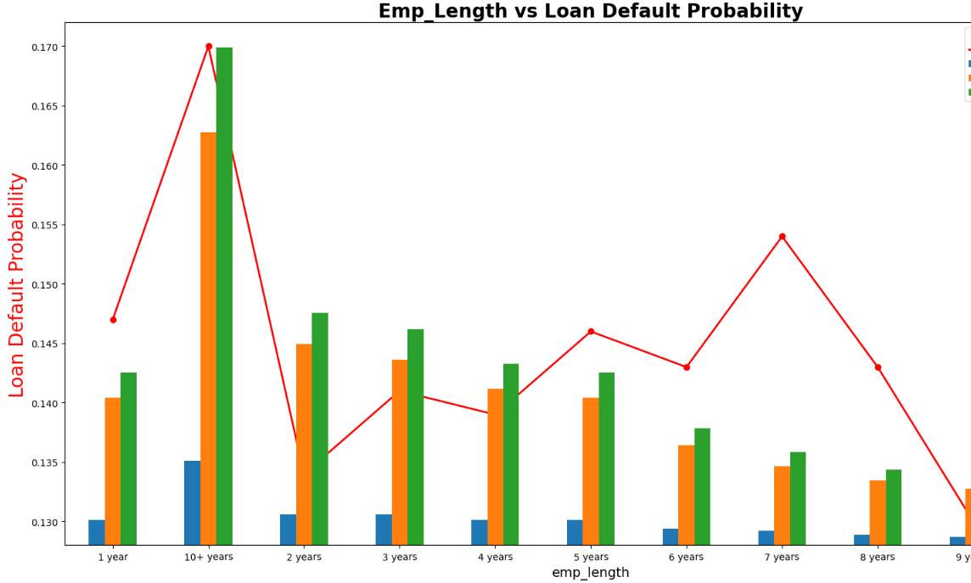
Employment length and verification status
Probability of defaulting is highest with emp length >10 years
Also, when the verified applicants are having higher chances of being a defaulter

Slide 28
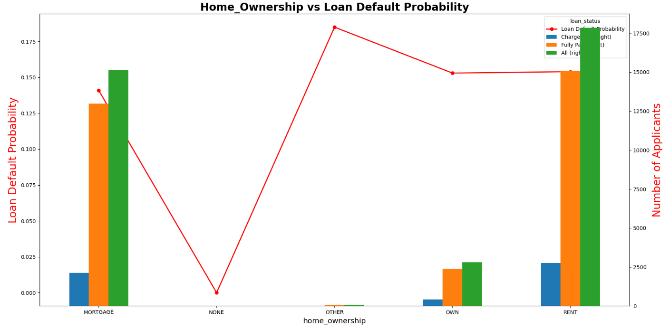
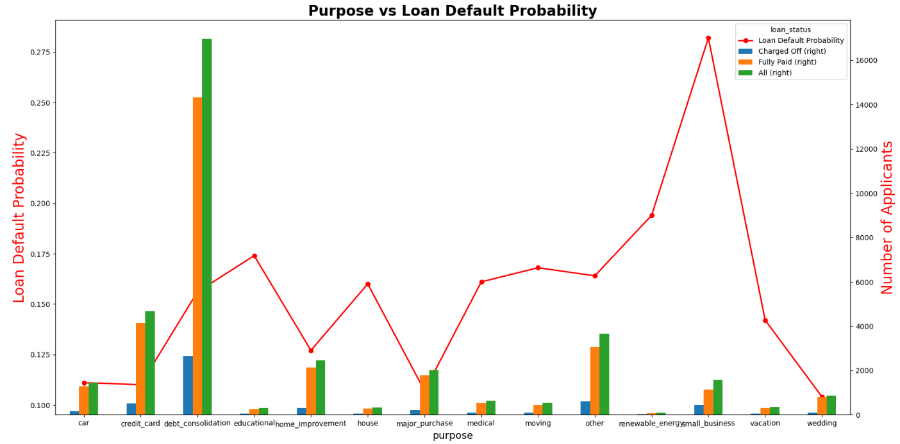
Purpose and home ownership
We can observe that defaulters and probability of defaulting is more when applicant is mortagaging
Also, when the purpose is to build small business, that time as well default rate and probability is higher

Slide 29
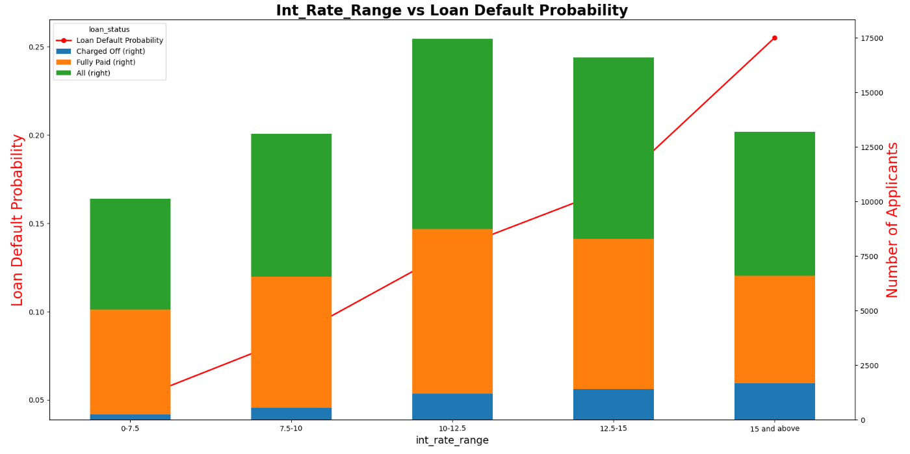
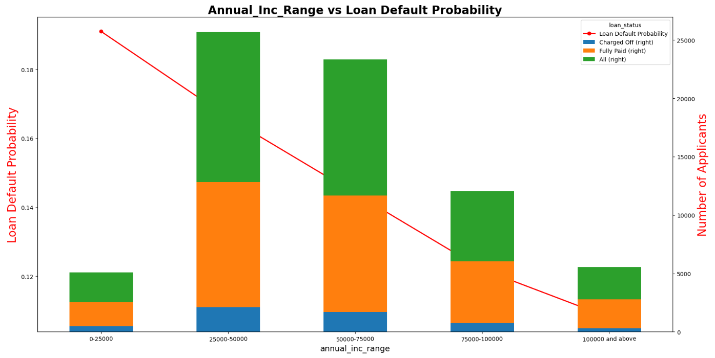
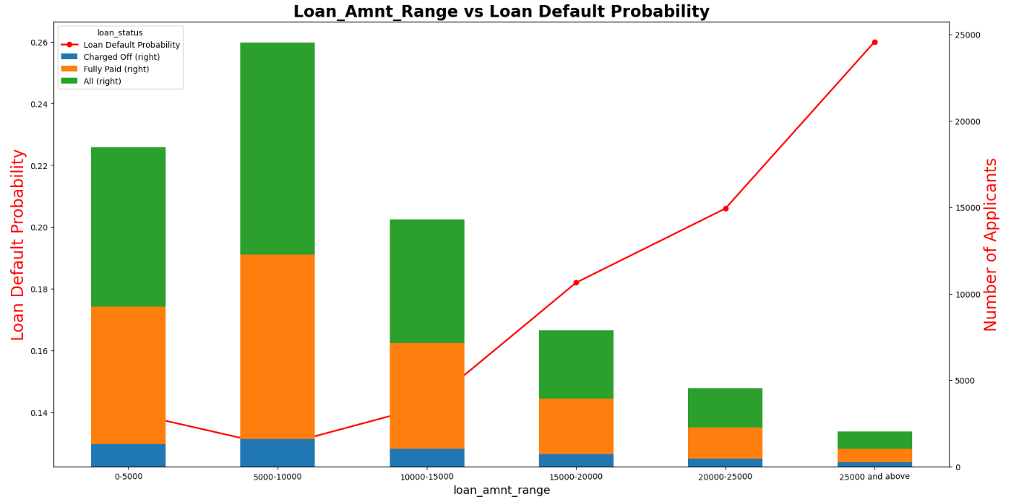
Interest rate range, loan amount and annual income
Default rate is higher when loan amount is >25K
Probability of being defaulter is higher when interest rate is >15%
Applicants with <25K annual income have higher chances of being a defaulter

Slide 30
Final observation and patterns

Slide 31
Following are the patterns of applicants with probability of being a defaulter in future
With home ownership as 'MORTGAGE'
Having loan at interest rate of >15%
Falling in grade F and G with sub grades in Fs and Gs
Having employment length of > 10 years but with less annual income
Purpose is to build small business
Loan amount is >25000
With annual income below 25000
With a verified loan status

Slide 33
Contributors
Snehal Amol Jadhav
Shrey Kumar Jain

